Slide 1
Page 1

Slide 2
Presentation’s Structure
Business Model - Resident Shows
Internal Organisation
Future Expansion
Page 2

Slide 3
Presentation’s Structure
Business Model - Resident Shows
Internal Organisation
Future Expansion
Page 3

Slide 4
The business model offers numerous advantages…
Large partners
Efficiency
High financial capabilities
-
Huge customer base
Share each other R&Cs
Exclusive show
More profitable
Uniqueness
-
Luxurious
Lower break-even point
Page 4

Slide 5
… But the level of dependency with your partners is risky…
Cirque du Soleil
Create specific & unique show
Resident Show Partner
Build specific theatres
Both have power on one another
Partners have more amplitudes to absorb the impact of losing the relationship
Page 5

Slide 6

… as well as the loss of opportunity.
Unique
Multiple
Venue A
$
Venue B
$
$
Show
Venue A
Show
Venue C
$
Venue D
$
Does it really make sense financially and on a business development point of view ?
Page 6

Slide 7
Overall, this business model is a good one, maintain it !
High investment on both sides
=
better not to integrate
Loose-Loose situation in case of conflict
+
Trust is a key asset in the relationship
→ Cherish it !
Page 7

Slide 8
Presentation’s Structure
Business Model - Resident Shows
Internal Organisation
Future Expansion
Page 8

Slide 9


Integrated creative process is recommended, unlike outsourced variant…
Outsourcing this key department would bring severe negative effects
→ Dependency and lack of authority would be too important for a safe outsourced relationship
No incentive to invest resources
Constant renegotiations
Page 9

Slide 10



… but integration also brings its shares of issues
Coordination Issue
Abuse of Power
Lack of Flexibility
High dependency = lower authority
Few creative directors + extensive growth strategy = exhausted employees
Key processes not understood by everyone
Moreover, there was a very important risk of hold-up inside your company
Page 10

Slide 11
Standardized Process : A decision that makes sense
Coordination Issue
Abuse of Power
Lack of Flexibility
Knowledge is spread
-
Authority increases
Responsibility is shared
Employees can easily take over the process if needed
The power of the “prima dona” creators is heavily lowered
Page 11

Slide 12
…However, we recommend to develop a hybrid organisation
What ?
Mixing both the advantages of the standardized process while still having one (or few) famous stage director
Why ?
How ?
Spotlight one of your most talented stage director
The chosen artist will develop a new process that will be shared transparently with all other artists
Stage director | # of shows created (1992 – 2007) | Tickets sold
Franco Dragone | 6 (40%) | 50.5 millions (72%)
Others | 9 (60%) | 19.5 millions (28%)
Cirque du Soleil | 15 | ~70 millions
Prima Dona artists seems to attract massively spectators
Page 12

Slide 13
Presentation’s Structure
Business Model - Resident Shows
Internal Organisation
Future Expansion
Page 13

Slide 14



Three main reasons why the London & Montreal Projects did not work
Lack of Credibility /Expertise
Slowness of Development
Lack of Creative control
Page 14

Slide 15
Our recommendation : Stay away from these types of projects…
Better partners ?
Difficult to achieve
Outsourcing ?
Too risky
Quicker process ?
Out of your control
Page 15
Notes:
How to improve your credibility ? Outsourcing hotels management tasks to companies who are already operating in this industry could be the easiest and fastest way to gain credibility towards bankers and other partners that you will need in the process.
The slowness of development is a crucial point that you can not easily accelerate, this is why, our point of view toward your expansions ideas is to give up such projects. They will be too much time consuming and require a lot of liquidities without any short term return.
As you have experienced, outsourcing some activities and dealing with new partners might lead to creavity issues. You will end up working with partners that would want to control and limit your creativity which could lead to negative advertisement as spectators could be disapointed by your shows as their experience would not match their expectancies. You might lose your competitive advantage.
For these reasons we advise you to stick to your actual business model and stay away from these types of projects. You should allocate your ressources to expansion plans where your part is fully focused on resident shows.

Slide 16
… and focus fully on entering new markets instead
Dubai Project
Macao Project
Build strong relationships
-
Take moderated risks
(stake selling)
Apply your knowledge
Strong market researches
Page 16
Notes:
Warranty to enter a new market that is already well equiped for shows and mega events. In Vegas, you were there from the beginning and helped the companies to grow a mutual confidence grew over time. In this case you need to build confidence on the late run. As they are investing 20%, they are expecting positive returns so they will do their best to help for your success. Moreover, 20% isn’t enough to influence the company’s decisions.
Of course, making the largest specific-investment in the relationship and the 20% shares investment might look like a forward integration move, however, your company’s crucial source of asset is your Human Capital which can’t be bought, this is why you should take this risk.
Remains the majority shareholders, the subdiaries don’t have to much impact on the management of Cirque du Soleil but you shouldn’t diluate the share any further.

Slide 17
For further expansion plans: Focus on resident shows
Market prospection using touring shows
Find new profitable location
Better assets allocation
Build partnerships with local companies
Allocate touring show resources for the new project
Page 18
Notes:
Open new residents shows around the world if total creative control and profitable.
Maintaining bit-top touring shows and/or arenas ? Not as your main source of revenu but in order to gain visibility in new potential markets to see how different cultures appreciate your shows, then if the success is real, resident shows can be considered.
According to us, your reputation is made, touring shows made you famous in strategic locations to obtain the great deals you’ve made with your partners but are not the most valuable. You should focus your efforts and investments in the resident show where the break-even and occupancy are the largest.
For each new resident show created, you should allocate your touring shows’ human capital (artists) to these resident shows instead of hiring and training new people. This would result in a better asset allocation. It is the best way to focus on the most profitable shows.
Sell share in company ? → Be forward integrated by a huge hotel company ? Not necessary as long as you maintain healthy relationships with your partners + You don’t have haggling costs so no reason to do so

Slide 18
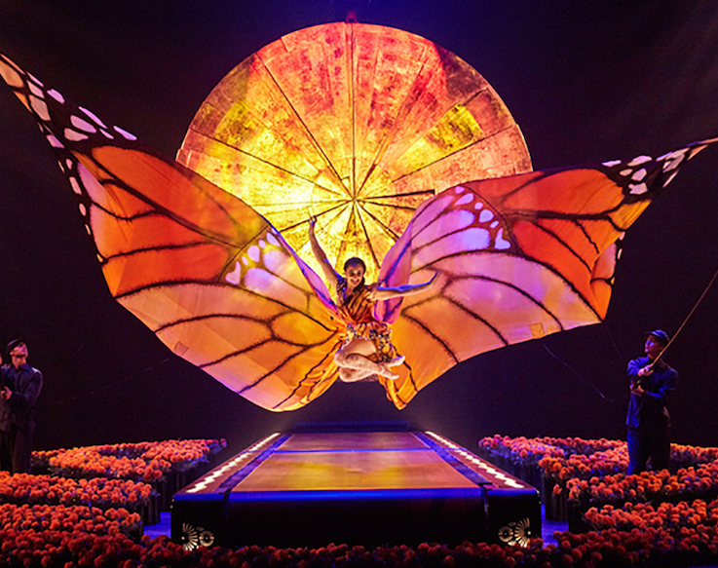
Q&A session
Page 19

Slide 19
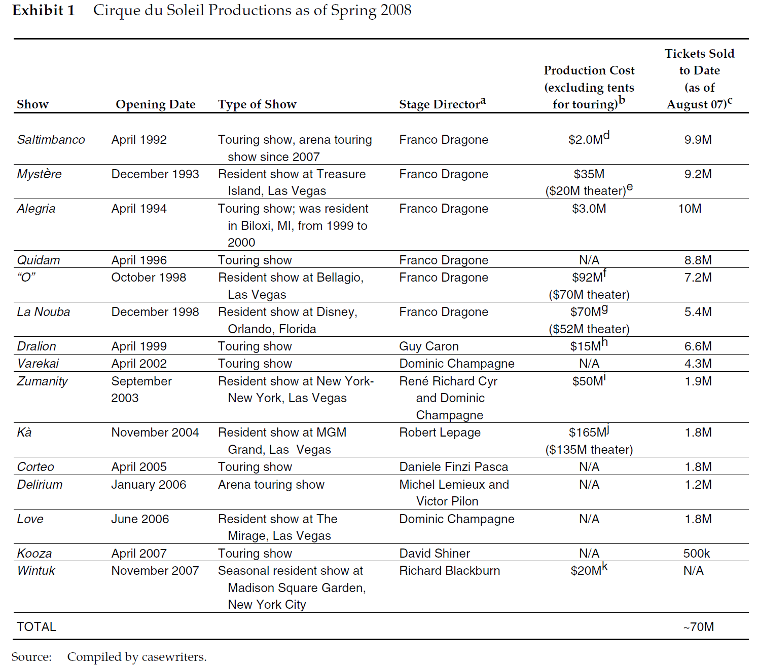
ANNEX 1
Page 20

Slide 20
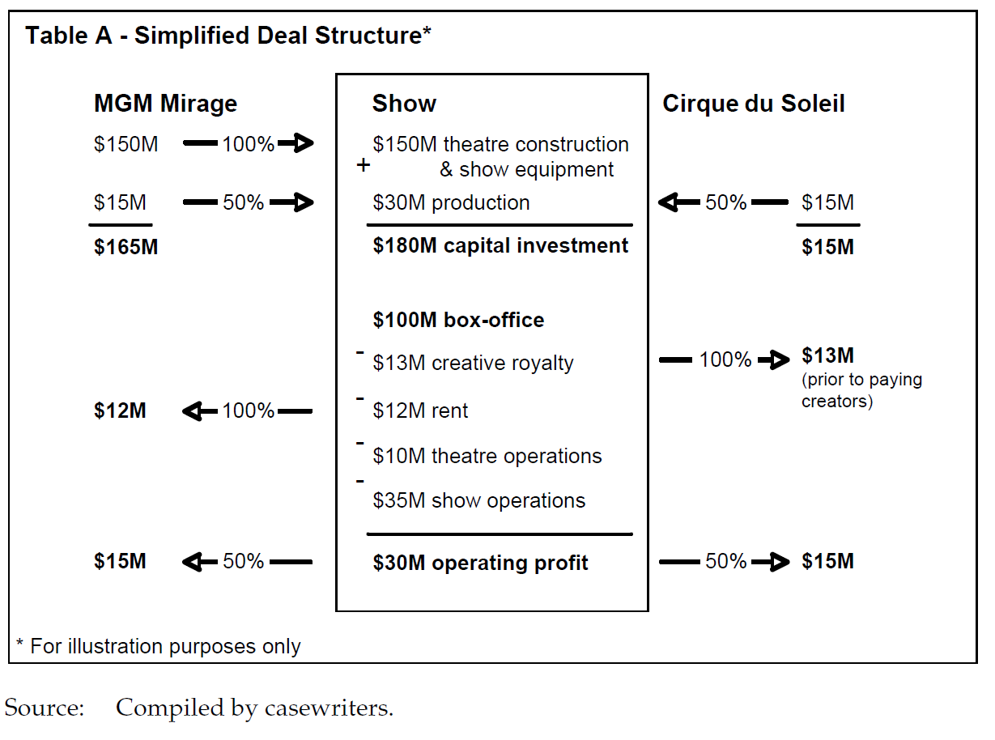
ANNEX 2
Page 20

Slide 21
ANNEX 3 - Resources
R. Casedeus-Masanell & M. Aucoin, Cirque du Soleil – The High-Wire Act of Building Sustainable Partnerships, Harvard Business Review, February 2010
Page 20

